Slide 1
CUSTOMER REVIEW CLASSIFICATION USING NATURAL LANGUAGE PROCESSING
DATA606 Capstone Data Science
Bhanu Harish Surisetti
Jessie Caroline Merugu
Sreeja Pendota

Slide 2
Aim of the project
The objective of the project is to use NLP and machine learning techniques to predict customer satisfaction level with products based on their reviews.
In this project we will use NLP and machine learning techniques to predict the fake reviews based on the review text.

Slide 3
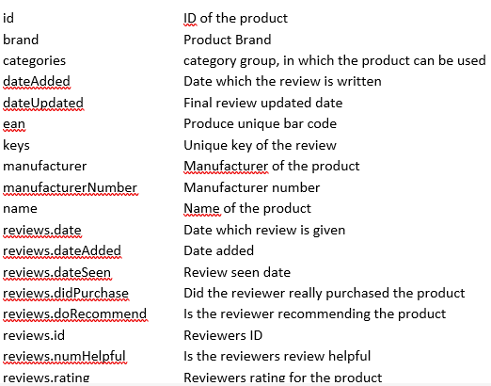
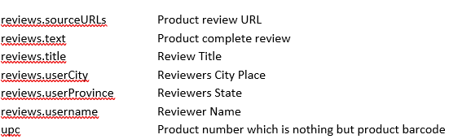
Data Source
https://www.kaggle.com/code/duttadebadri/detailed-nlp-project-prediction-visualization/data
Size of the Data Set: 99.44MB
Rows : 71044
Columns : 25

Slide 4
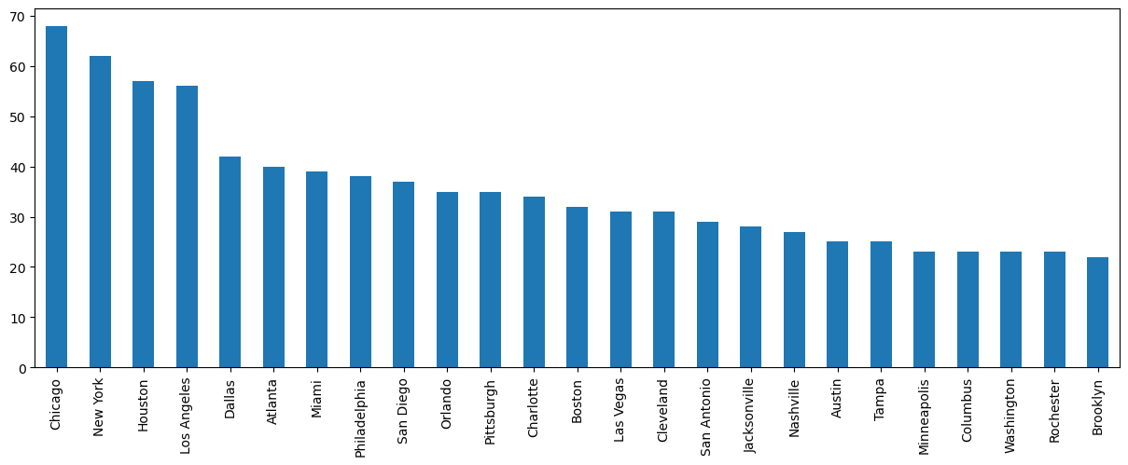
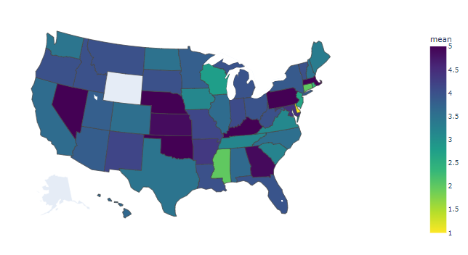
Pre-processing the data

Slide 5
Observations of state wise analysis on the reviews and review rating
Based on the choropleth map, it appears that people from certain states, such as NE, NY, MA, PA, KY, and OK, have given higher average ratings than people from other states.
The data suggests that California residents have provided more ratings compared to residents of other states.
Out of a total of 70,000 records, only 447 include information about the reviewer's state. Therefore, it is difficult to draw conclusions about the impact.
of state on the ratings provided based on this limited sample size.

Slide 6
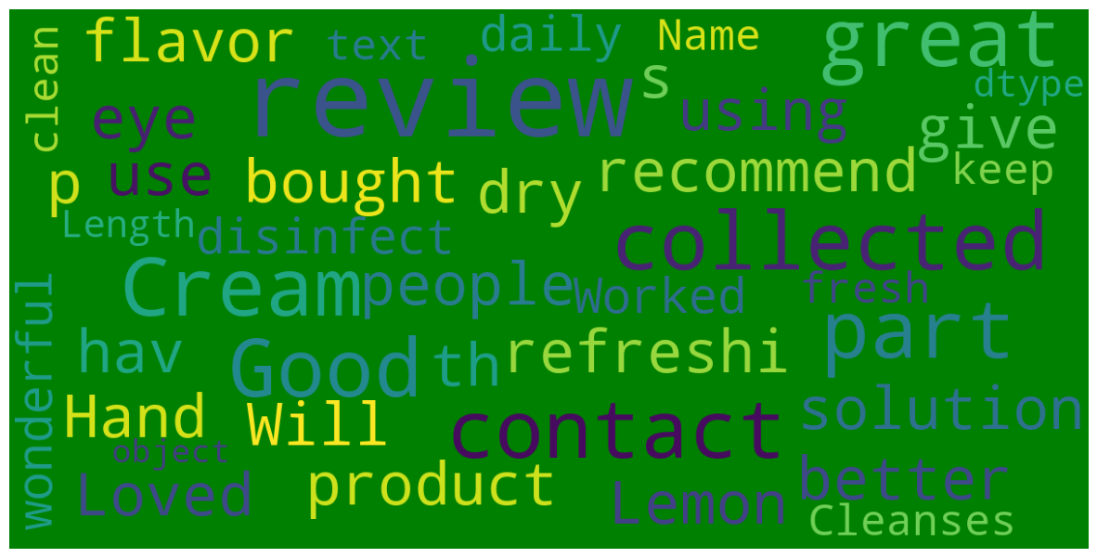
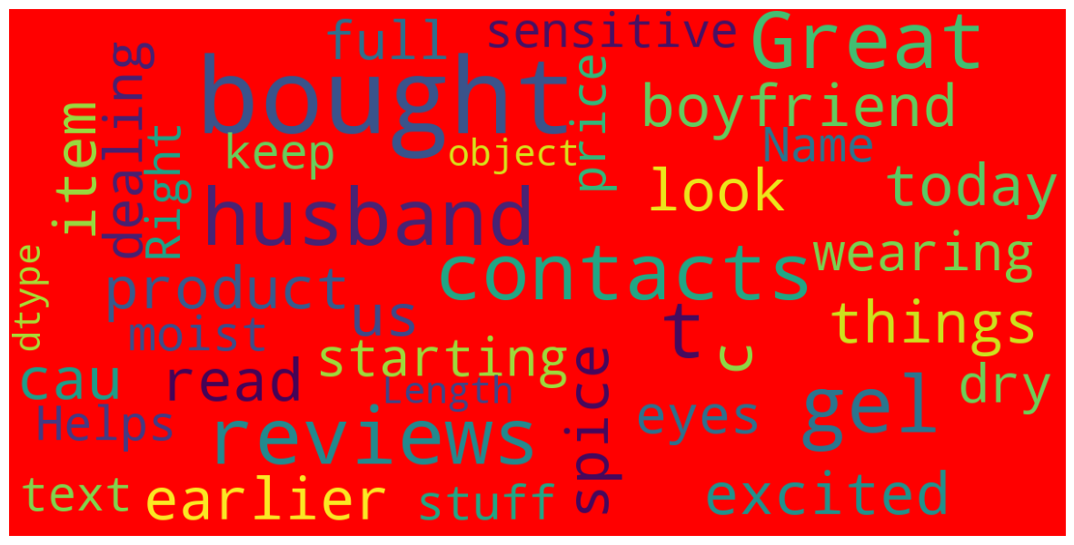
Most used words in reviews

Slide 7
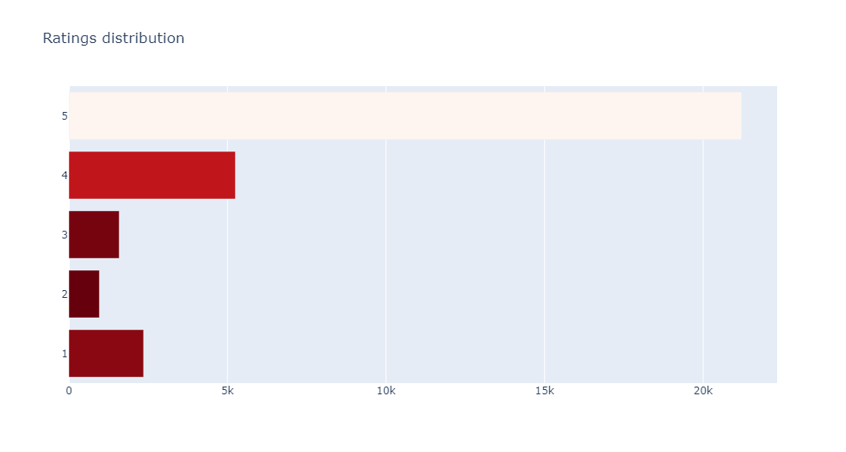
Ratings Distribution
It can be observed that within the range of ratings from 1 to 5,the frequency of reviews is at its lowest point for a rating of 2.
One can note that the frequency of reviews is highest for a rating of 5 within the range of ratings from 1 to 5.

Slide 8
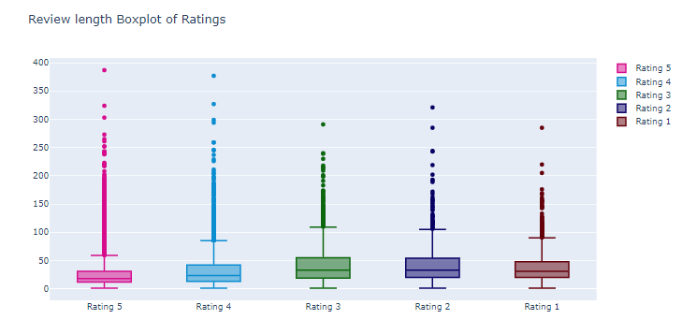
Box plot to visualize the distribution of ratings based on review text length
From the box plots, we can infer that there are outliers in the data for the ratings.
The average words used for the rating 5 is around 18
The average words used for the rating 1 is around 31

Slide 9
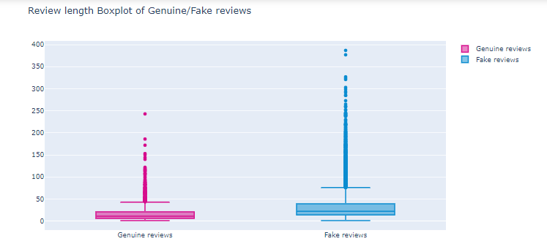
Box plot to visualize the fake and genuine reviews based on review text length
From the box plot we can infer that the maximum words are used for the fake review.
The highest count of words for the fake review is 387
The average number of words used for the fake review is 22.
The average number of words used for the genuine review is around 11 words.

Slide 10
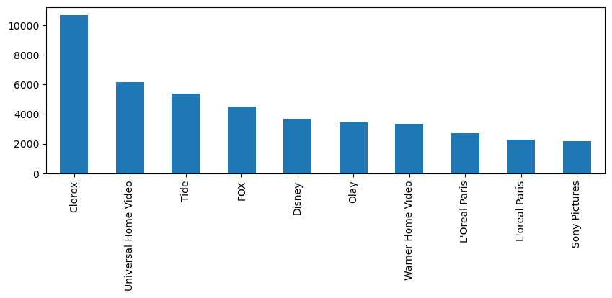
EDA
It is evident that Clorox stands out as a leading brand, outperforming other brands with its high customer ratings and maximum sales figures
Universal Home Video holds the position of the second most recognized brand on a scale of 1 to 10 brands.

Slide 11
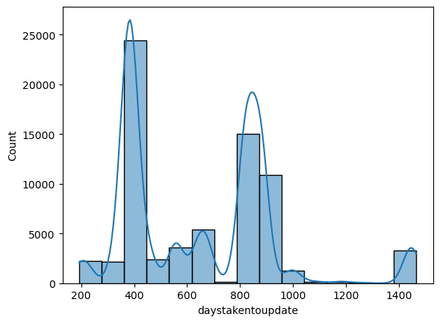
EDA
It can be observed that, people were taking around 400 days to update their review.
The second highest time gap taken to update the review is around 800 days

Slide 12
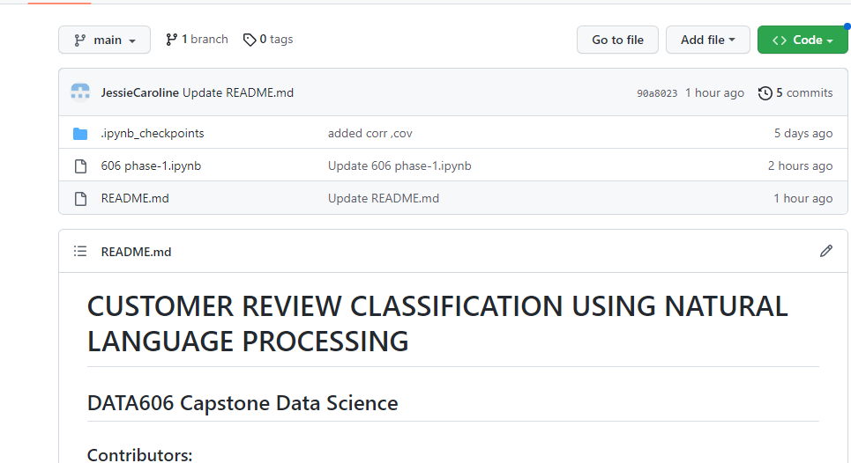
GitHub
Link: https://github.com/JessieCaroline/Data606-TeamC

Slide 13
Further EDA and Machine Learning Algorithms
EDA will be performed to analyze the correlation between review rating and the number of words used in the review text, as well as to visualize which words are used most and check if there is any regional impact on the reviews provided.
The project also plans to use future classifiers such as Naïve Bayes Classifier, KNN, and XLNet to improve accuracy. Overall, the project seeks to use NLP and machine learning to better understand customer satisfaction and to identify factors that influence it.

Slide 14
Reference
https://www.projectpro.io/article/machine-learning-nlp-text-classification-algorithms-and-models/523
Olsson, Fredrik. "A literature survey of active machine learning in the context of natural language processing." (2009).
https://www.diva-portal.org/smash/record.jsf?dswid=-8182&pid=diva2%3A1042586

